Slide 1
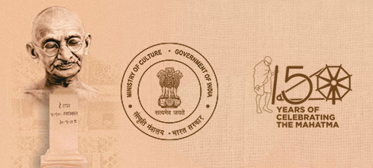
Practicing Active Nonviolence in the 21st Century
Martin Arnold
Ahimsa Mandap, Tagore Hall, Gandhi Darshan, Rajghat, New Delhi 110002, INDIA
25th of February, 4:00 p.m., 2020
Notes:
Mr. Director Shri Gyan, Mr. Chairman Prof. Radhakrishnan, thank you very much for inviting me to give this lecture and for organising it even in only few time. And for your kind introduction.
Ladies and Gentlemen, thank you for coming here.

Slide 2
Practicing Active Nonviolence in the 21st Century
Martin Arnold
Ahimsa Mandap, Tagore Hall, Gandhi Darshan, Rajghat, New Delhi 110002, INDIA
February 25th, 4:00 p.m., 2020
Notes:
It is a great honour to present some of my research in this great city New Delhi, where Gandhiji worked and spent the last days of his life. I am deeply touched by this. It is also especially moving for me to have Mrs. Bhardwaj and two of my children here this afternoon.

Slide 3
Practicing Active Nonviolence in the 21st Century
Martin Arnold
Ahimsa Mandap, Tagore Hall, Gandhi Darshan, Rajghat, New Delhi 110002, INDIA
February 25th, 4:00 p.m., 2020
Notes:
I am delighted to be talking today about Practicing Active Nonviolence in the 21st Century. However, I want to change the title but not the content of this lecture and will tell you why.

Slide 4
Fridays for Future
The terms nonviolence, satyagraha, Power of goodness
Satyagraha: a turning point in human history
Satyagraha since the beginning of the 21st century
15.2.2003: biggest protest event in human history
“Antiglobalization movement“ / Social Forums
Nonviolent Peaceforce
Otpor in Serbia and Arab spring
3 main dynamic aspects of the satyagraha approach
Rules of satyagraha (in a general sense)
Notes:
My talk is divided into 6 main parts

Slide 5
Fridays for Future
The terms nonviolence, satyagraha, Power of goodness
Satyagraha: a turning point in human history
Satyagraha since the beginning of the 21st century
15.2.2003: biggest protest event in human history
“Antiglobalization movement“ / Social Forums
Nonviolent Peaceforce
Otpor in Serbia and Arab spring
3 main dynamic aspects of the satyagraha approach
Rules of satyagraha (in a general sense)
Notes:
Here in India there is a great new movement which was launched only a few months ago.

Slide 6
Fridays for Future
The terms nonviolence, satyagraha, Power of goodness
Satyagraha: a turning point in human history
Satyagraha since the beginning of the 21st century
15.2.2003: biggest protest event in human history
“Antiglobalization movement“ / Social Forums
Nonviolent Peaceforce
Otpor in Serbia and Arab spring
3 main dynamic aspects of the satyagraha approach
Rules of satyagraha (in a general sense)
Notes:
But unfortunately people have been subjected to great brutality. This Indian movement seems remarkable as a satyagraha movement because it has been triggered by elder Moslem women and also for other reasons.

Slide 7
Fridays for Future
Notes:
But you know much more about it than I do. So let me tell you what is going on currently in my own home town, Essen, Germany.

Slide 8
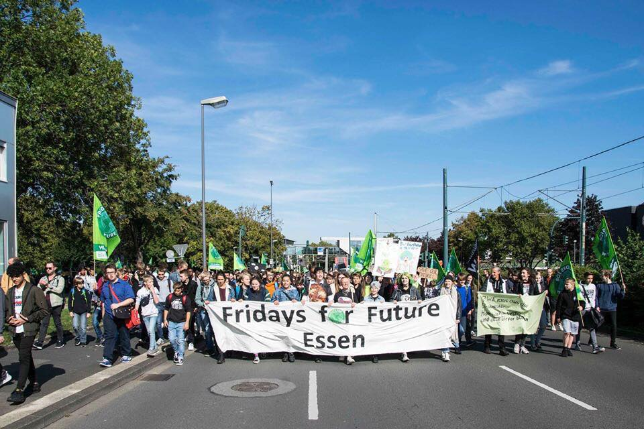
Notes:
Every Friday young people go out onto the streets to demonstrate for effective policies to combat climate change. They do this at a time when they are legally required to attend lessons in school. I suspect that most of the participants in this recent worldwide satyagraha movement „Fridays For Future“ do not know

Slide 9
Notes:
that it was Gandhi who not only made civil disobedience both known throughout the world and also through his personal trustworthiness and modesty, made civil disobedience acceptable by protesters as a potentiallly effective means and

Slide 10
Notes:
acceptable to others as a legitimate means of protest so long as the aims of the action serve the common good, i.e. the action is motivated by a noble cause and therefore a noble way of breaking the law.

Slide 11
Notes:
There were already interesting developments as regards satyagraha at the beginning of this century, however. But before I talk about them I would like to clarify a few terms.

Slide 12
Fridays for Future
The terms nonviolence, satyagraha, Power of goodness
Notes:
Gandhiji gave a huge gift to the world, which is extremely important: satyagraha, which is referred to internationally as “nonviolence”.

Slide 13
Mohandas K. Gandhi: Satyagraha = „the Force which is born of Truth and Love“ love-force, strength of love, truth-force, soul-force
ahimsa = Non-violence
Abdul Ghaffar Khan: Patience and Justice
Martin Luther King: Strength to Love
Lanza del Vasto: Force de la justice = force of justice
Latin Amerika: Firmeza permanente = permanent firmness
Philippines: Alay Dangal = offering dignity
People Power
In many countries: Active Nonviolence
Quaker, Martin Arnold: Power of goodness, Gütekraft
Notes:
In 1908, Gandhi explained the meaning of this new word which he has coined. He wrote: Satyagraha is “the force which is born of truth and love”.

Slide 14
Mohandas K. Gandhi: Satyagraha = „the Force which is born of Truth and Love“ love-force, strength of love, truth-force, soul-force
ahimsa = Non-violence
Abdul Ghaffar Khan: Patience and Justice
Martin Luther King: Strength to Love
Lanza del Vasto: Force de la justice = force of justice
Latin Amerika: Firmeza permanente = permanent firmness
Philippines: Alay Dangal = offering dignity
People Power
In many countries: Active Nonviolence
Quaker, Martin Arnold: Power of goodness, Gütekraft
Notes:
In English Gandhi sometimes used “love-force“ or „soul force“, but he usually used the term “non-violence”. This is not a translation of satyagraha, however, but of “ahimsa”. In India, ahimsa, non-violence, has a great tradition of personal strength, diligently kept up in the ancient Jain tradition.

Slide 15
Mohandas K. Gandhi: Satyagraha = „the Force which is born of Truth and Love“ love-force, strength of love, truth-force, soul-force
ahimsa = Non-violence
Abdul Ghaffar Khan: Patience and Justice
Martin Luther King: Strength to Love
Lanza del Vasto: Force de la justice = force of justice
Latin Amerika: Firmeza permanente = permanent firmness
Philippines: Alay Dangal = offering dignity
People Power
In many countries: Active Nonviolence
Quaker, Martin Arnold: Power of goodness, Gütekraft
Notes:
In Western countries, however - I live in Germany - violence is usually seen as something strong, so that non-violence, as a new term, is seen as something weak. This is most unfortunate. Gandhi spoke of a force and through his successes demonstrated that it is a strong one – even though he was not always successful.

Slide 16
Mohandas K. Gandhi: Satyagraha = „the Force which is born of Truth and Love“ love-force, strength of love, truth-force, soul-force
ahimsa = Non-violence
Abdul Ghaffar Khan: Patience and Justice
Martin Luther King: Strength to Love
Lanza del Vasto: Force de la justice = force of justice
Latin Amerika: Firmeza permanente = permanent firmness
Philippines: Alay Dangal = offering dignity
People Power
In many countries: Active Nonviolence
Quaker, Martin Arnold: Power of goodness, Gütekraft
Notes:
In the West we have to stress that it is not a question of not doing something, of not using violence, but rather of strong activity. Others beside Gandhi have also developed similar ways of overcoming grievances and social wrongs and coined their own terms for these processes.

Slide 17
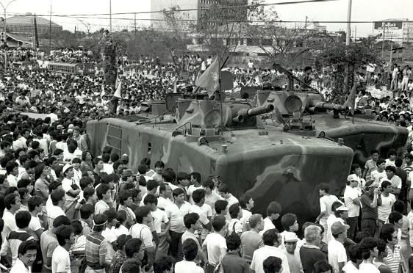
Offering Dignity
People Power
Manila, 24. 2. 1986 „Menschenmenge stoppte Panzer“ (WAZ)
Notes:
The Philippines for example called their model "offering dignity“. Act with dignity, end dictatorship, do not support Marcos’ regime any more, - you as a soldier for example.

Slide 18
Offering Dignity
People Power
Manila, 24. 2. 1986 „Menschenmenge stoppte Panzer“ (WAZ)
Notes:
By applying this model or concept they created “people power” and brought about the nonviolent overthrow of the Marcos dictatorship in 1986. This event is known internationally as the Rosary Revolution.

Slide 19
Mohandas K. Gandhi: Satyagraha = „the Force which is born of Truth and Love“ love-force, strength of love, truth-force, soul-force
ahimsa = Non-violence
Abdul Ghaffar Khan: Patience and Justice
Martin Luther King: Strength to Love
Lanza del Vasto: Force de la justice = force of justice
Latin Amerika: Firmeza permanente = permanent firmness
Philippines: Alay Dangal = offering dignity
People Power
In many countries: Active Nonviolence
Quaker, Martin Arnold: Power of goodness, Gütekraft
Notes:
In order to transfer Gandhi’s idea of satyagraha to the West I prefer the translation used by many Quakers: the Power of goodness. In German: Gütekaft.

Slide 20
Mohandas K. Gandhi: Satyagraha = „the Force which is born of Truth and Love“ love-force, strength of love, truth-force, soul-force
ahimsa = Non-violence
Abdul Ghaffar Khan: Patience and Justice
Martin Luther King: Strength to Love
Lanza del Vasto: Force de la justice = force of justice
Latin Amerika: Firmeza permanente = permanent firmness
Philippines: Alay Dangal = offering dignity
People Power
In many countries: Active Nonviolence
Quaker, Martin Arnold: Power of goodness, Gütekraft
Notes:
Today I will refer to all the various models as “satyagraha”.

Slide 21
Practicing satyagraha, the Power of goodness, in the 21st Century
Martin Arnold
Ahimsa Mandap, Tagore Hall, Gandhi Darshan, Rajghat, New Delhi 110002, INDIA
February 25th, 4:00 p.m., 2020
Notes:
And I am changing the title – not the content - of my lecture into “Practicing satyagraha, the Power of goodness, in the 21st Century“

Slide 22
Practicing satyagraha, the Power of goodness, in the 21st Century
Fridays for Future
The terms nonviolence, satyagraha, Power of goodness
Satyagraha: a turning point in human history
Notes:
Let me now explain why Gandhi’s gift of satyagraha is so important.

Slide 23
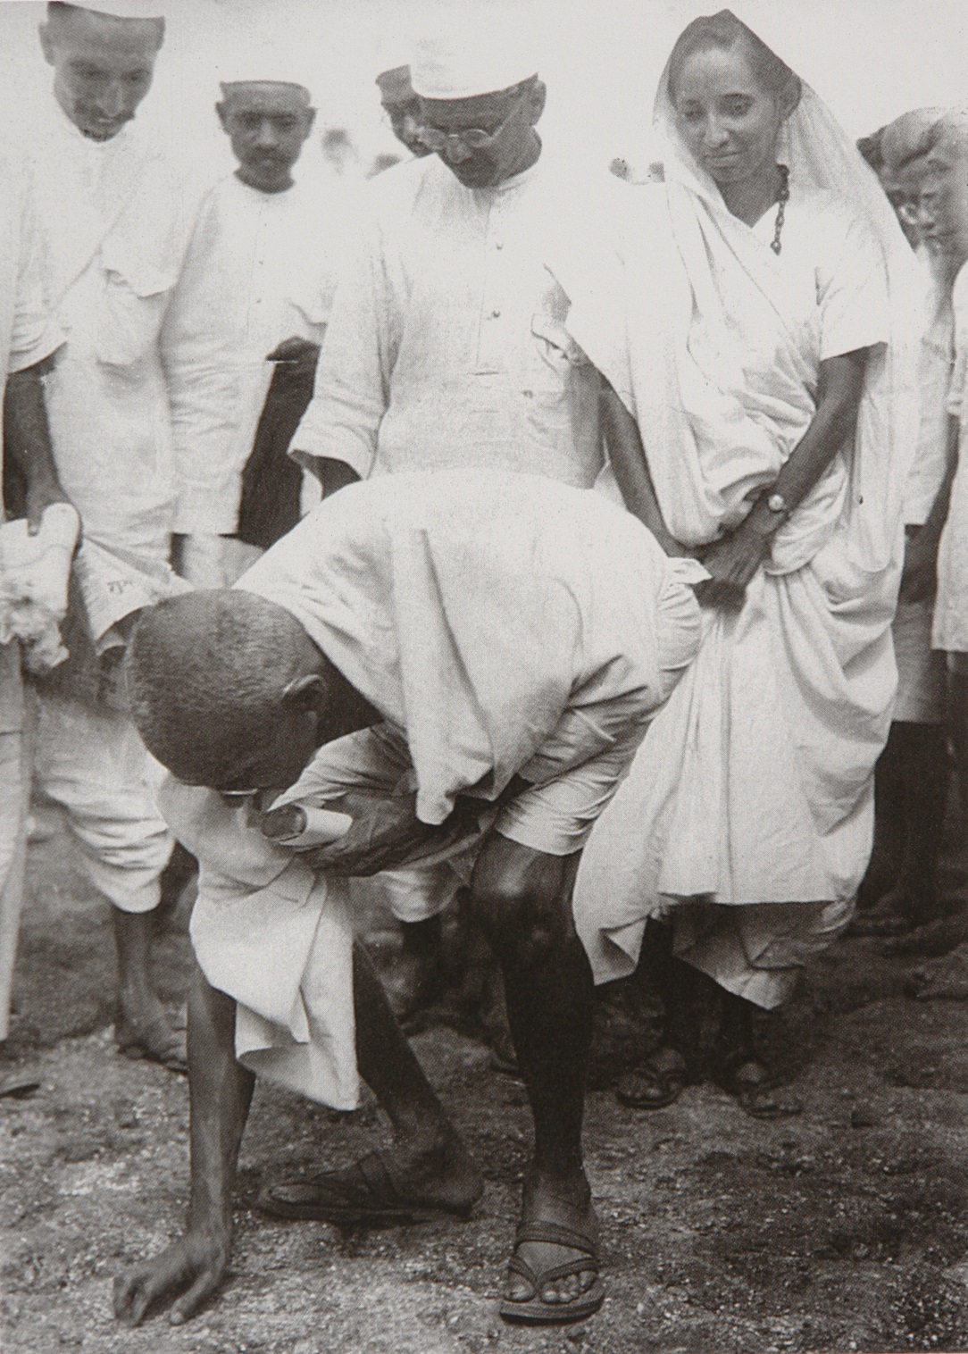
Gandhi: „Satyagraha is my life“
Finishing the Salt March 1930
Satyagraha =
Power of goodness
Notes:
Satyagraha is a powerful concept for dealing with grievances and all kinds of social wrongs. Gandhi developed and used it with maximum publicity, among other things in the struggle for India’s independence during the Salt March in 1930.

Slide 24
Gandhi: „Satyagraha is my life“
Finishing the Salt March 1930
Satyagraha =
Power of goodness
Notes:
Gandhi felt called to develop satyagraha and to make it known throughout the world. By doing so Gandhi generated a turning point in human history.

Slide 25
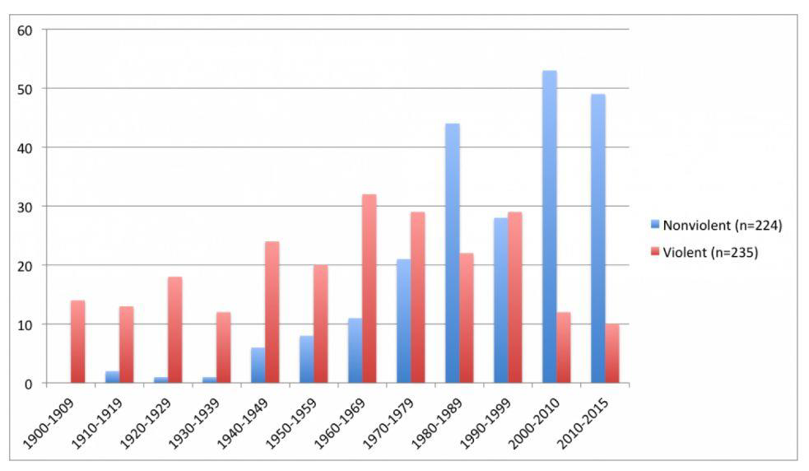
Source: Chenoweth/Stephan
Notes:
You may see this on the chart produced by the US-American social scientists Chenoweth and Stephan.

Slide 26
Source: Chenoweth/Stephan
Notes:
The chart shows when and how many campaigns for greater democracy have been launched worldwide in the time between 1900 and 2015. The violent campaigns are shown in red and the nonviolent ones in blue.

Slide 27
Source: Chenoweth/Stephan
Notes:
Before 1900 there were also single nonviolent campaigns worldwide. Some were successful like the boycott in Ireland in the 19th century.

Slide 28
Source: Chenoweth/Stephan
Notes:
They were a rare occurrence, because no-one had developed satyagraha as a concept or model which could be applied in a variety of situations. Sometimes satyagraha was only being applied spontaneously.

Slide 29
Source: Chenoweth/Stephan
1930 salt march
1947 India independent
1986 Philippine dictatorship ends
Notes:
It was India's model which set an example to be followed. And the later success in ending the Marcos dictatorship in the Philippines provided new momentum.

Slide 30
Source: Chenoweth/Stephan
1930 salt march
1947 India independent
1986 Philippine dictatorship ends
Since 2000 nonviolent campaigns became the norm
Notes:
Non-violent campaigns have become standard practice. It is Gandhi's great merit to have developed satyagraha as a successful mode of action for justice and made it known throughout the world.

Slide 31
Source: Chenoweth/Stephan
1930 salt march
1947 India independent
1986 Philippine dictatorship ends
Since 2000 nonviolent campaigns became the norm
Notes:
It is important because it is an effective means of putting right a social wrong in a positive way by improving social relations instead of harming one’s opponent.

Slide 32
Source: Chenoweth/Stephan
1930 salt march
1947 India independent
1986 Philippine dictatorship ends
Since 2000 nonviolent campaigns became the norm
Notes:
For huge numbers of people in many different countries around the world, living conditions have been improved through the practice of satyagraha. And new models for dealing with grievances and social wrongs have been developed and applied. The strong impulses which Gandhi gave continue to inspire even today to invent new concepts or models for particular situations.

Slide 33
Practicing satyagraha, the Power of goodness, in the 21st Century
Fridays for Future
The terms nonviolence, satyagraha, Power of goodness
Satyagraha: a turning point in human history
Satyagraha since the beginning of the 21st century
Notes:
Let us now return to the main question and consider satyagraha since the beginning of the 21st century. I will mention and comment on a few events which seem to me to be particularly relevant.

Slide 34
Practicing satyagraha, the Power of goodness, in the 21st Century
Fridays for Future
The terms nonviolence, satyagraha, Power of goodness
Satyagraha: a turning point in human history
Satyagraha since the beginning of the 21st century
15.2.2003: biggest protest event in human history
Notes:
There is one global event in 2003 which has to be mentioned: On the 15th of February 2003, eleven million people demonstrated in up to sixty countries against the war in Iraq announced by the USA. It was the biggest protest on a single issue in human history.
According to BBC News, between six and eleven million people took part in the protests in up to sixty countries over the weekend of 15 and 16 February. Other estimates range between eight million and thirty million.

Slide 35
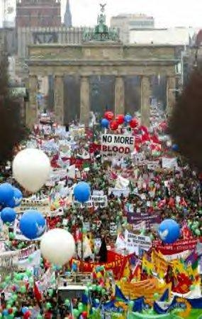
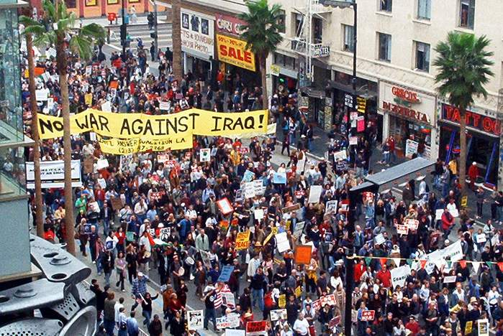
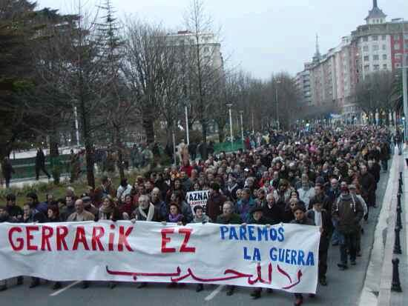
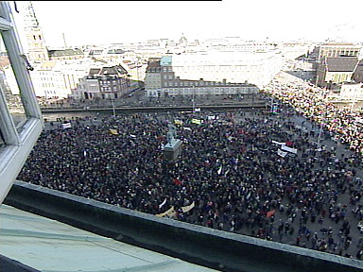
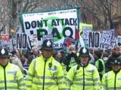
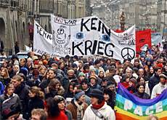
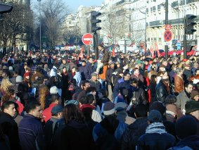
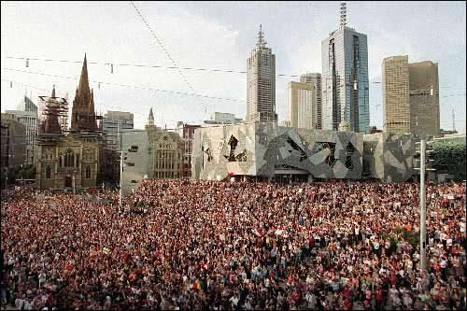
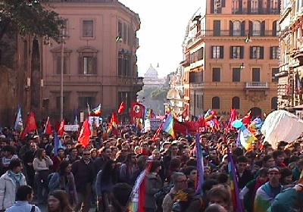
Practicing satyagraha, the Power of goodness, in the 21st Century
Notes:
In Germany, after the demonstration, the editorial team of one of the country’s leading newspapers, the Süddeutsche Zeitung, reconsidered its opinion about the war and choose to oppose it. But unfortunately the protest could not prevent the war.

Slide 36
Practicing satyagraha, the Power of goodness, in the 21st Century
Fridays for Future
The terms nonviolence, satyagraha, Power of goodness
Satyagraha: a turning point in human history
Satyagraha since the beginning of the 21st century
15.2.2003: biggest protest event in human history
“Antiglobalization movement“ / Social Forums
Notes:
Since the turn of the 21st century, whenever heads of state and global financial institutions come together, protest is not far away. The so called antiglobalisation movement emerged in opposition to neoliberal promotion of unfettered markets and free trade.

Slide 37
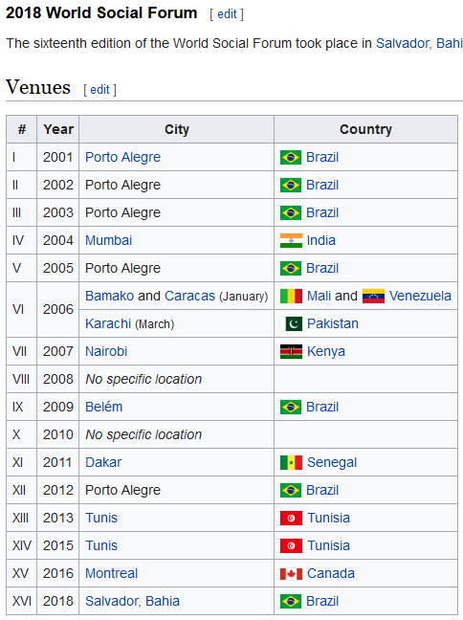
Notes:
But satyagraha is not only about protest. A constructive programme is essential. And social movements have organised World Social Forums since 2001.

Slide 38
Notes:
National, regional and local Social Forums had also been held in many countries. Some people see them as a "people’s university", an opportunity to make large numbers of people aware of the problems associated with globalisation.

Slide 39
https://en.wikipedia.org/wiki/World_Social_Forum
Notes:
Other people prefer that delegates concentrate their efforts on coordinating and organising the movement and on planning new campaigns. The venue of the World Social Forum 2019 was Barcelona, Spain. And the 2020 World Social Forum in April will also be held there.

Slide 40
Practicing satyagraha, the Power of goodness, in the 21st Century
Fridays for Future
The terms nonviolence, satyagraha, Power of goodness
Satyagraha: a turning point in human history
Satyagraha since the beginning of the 21st century
15.2.2003: biggest protest event in human history
“Antiglobalization movement“ / Social Forums
Nonviolent Peaceforce
Notes:
I regard Nonviolent Peaceforce as one of the most significant developments of satyagraha in the 21st century. It was set up after The Hague Appeal for Peace, an international conference which was held in the Netherlands in 1999.

Slide 41
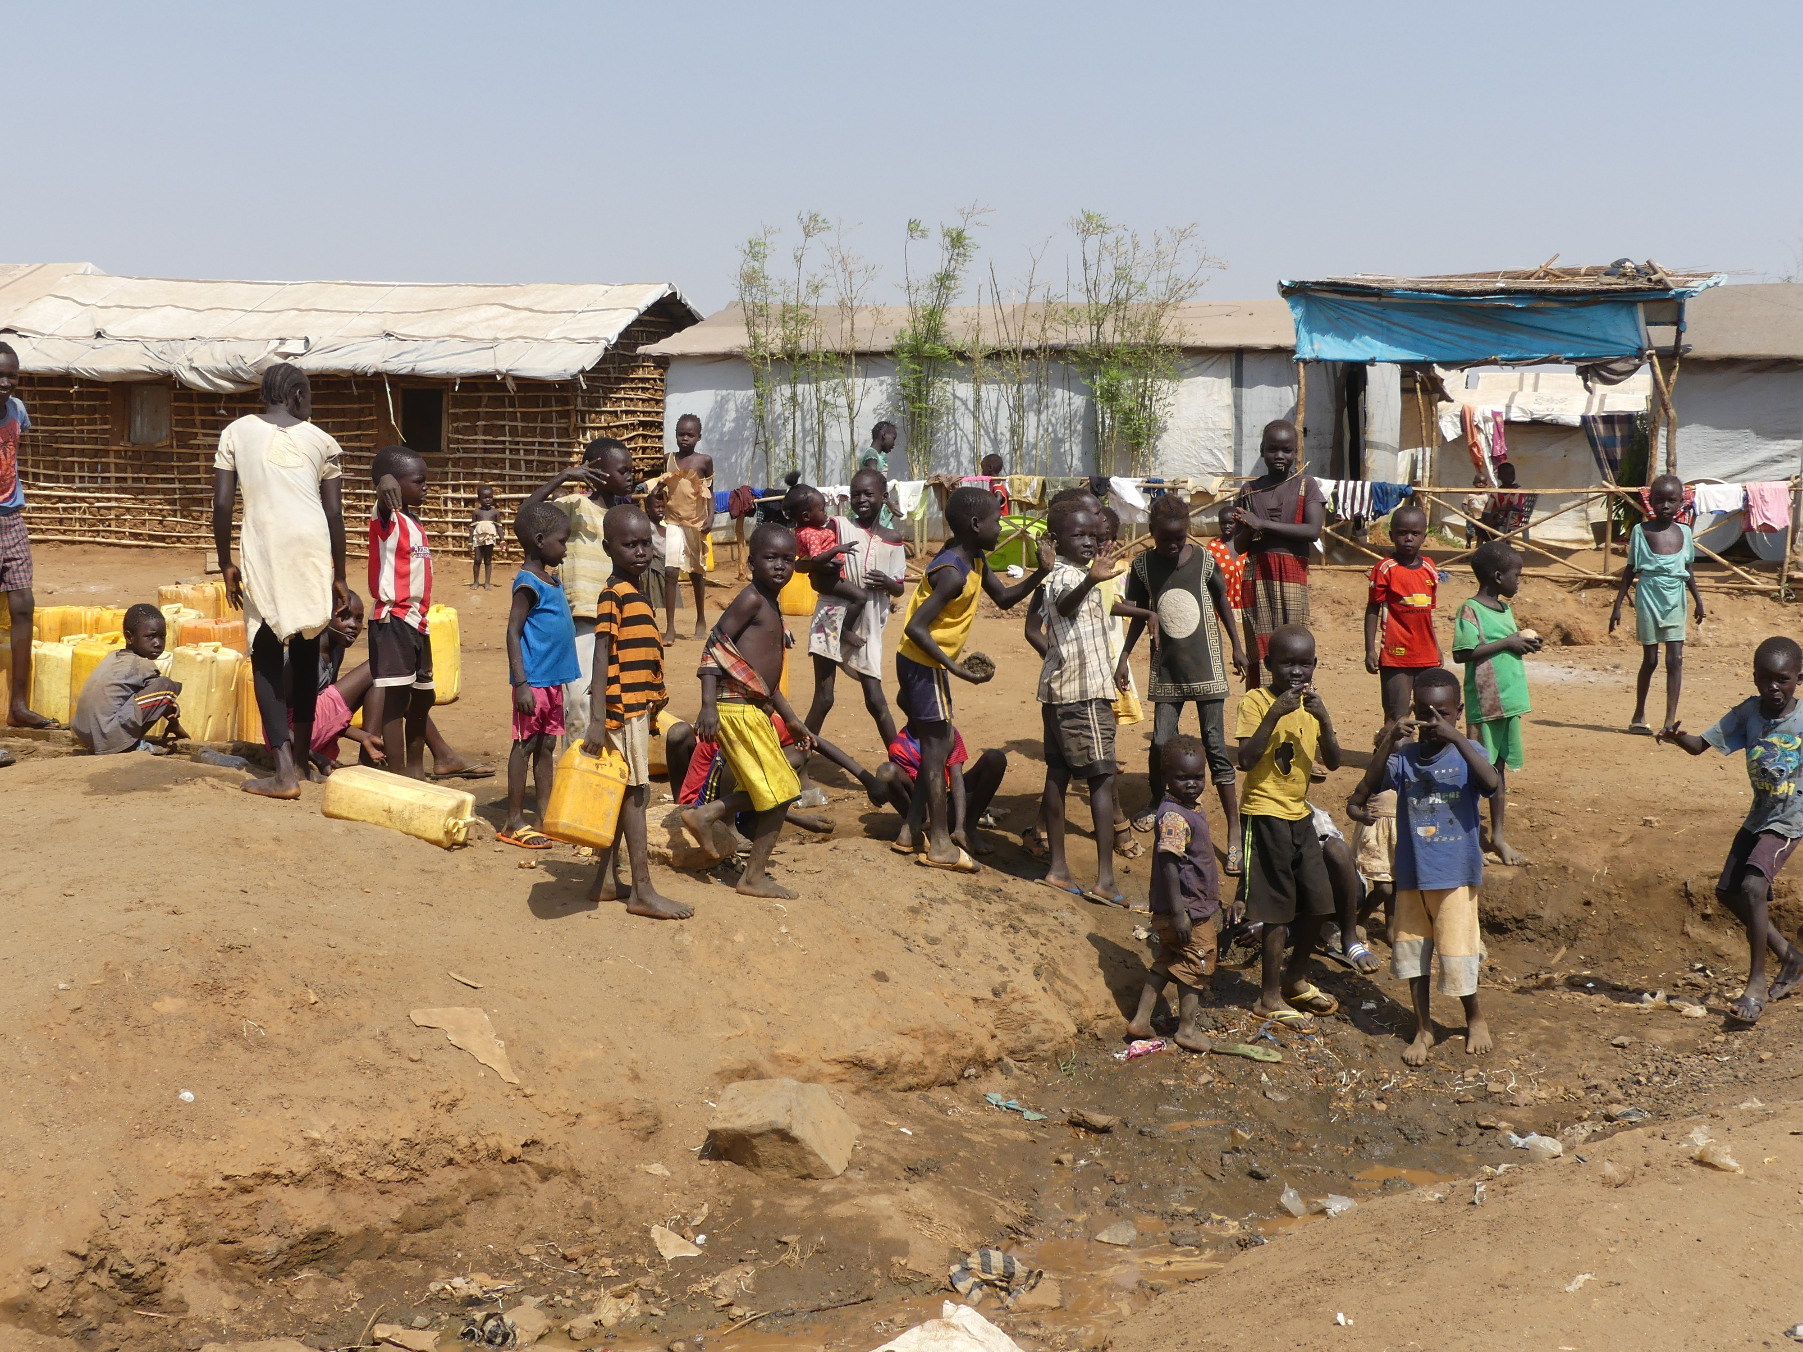
Water supply
Notes:
The people here are at a well in South Sudan. Many of them had come a long way through dangerous areas to get here.
An einer Wasserquelle im Südsudan. Viele kommen von weit her, um Wasser zu holen.

Slide 42
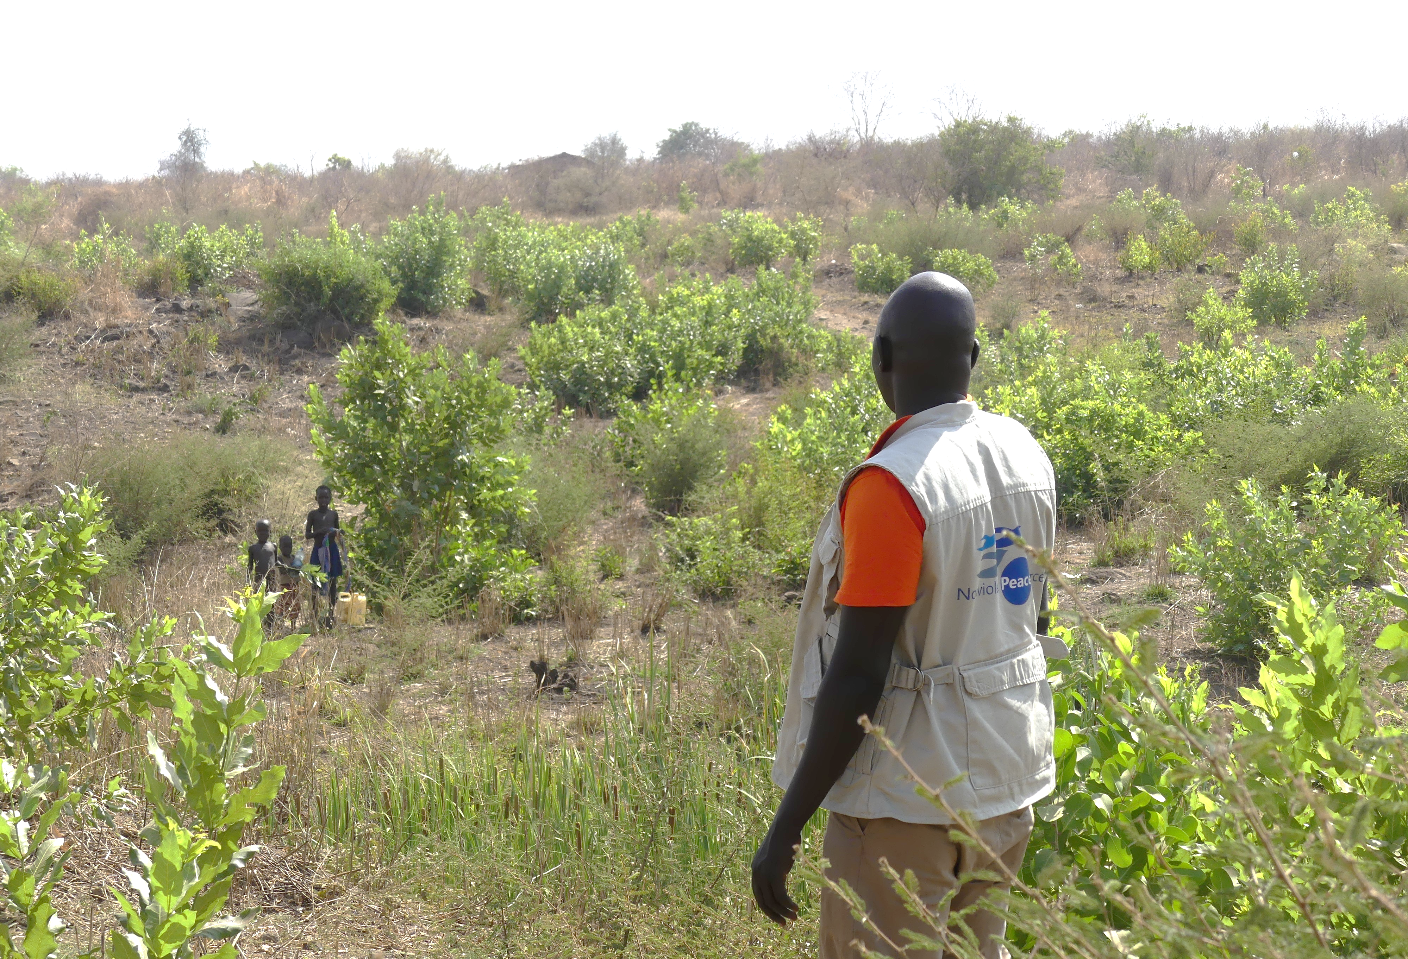
Water supply
Notes:
A man is watching over the site. Three children are carrying water. Here in South Sudan, this is a picture of success. The man does not pose a threat to the children. The Nonviolent Peaceforce logo on his jacket says that his presence protects the people who walk this way – from being raped, for example.
Ein Mann beobachtet das Gelände. Drei Kinder holen Wasser. Dies ist ein Erfolgsbild aus dem Südsudan. Dieser Mann lauert dem Mädchen nicht auf. Er hat ein Logo auf der Jacke: Nonviolent Peaceforce. Seine Anwesenheit beschützt die Menschen auf diesem Weg, viele holen hier Wasser.

Slide 43
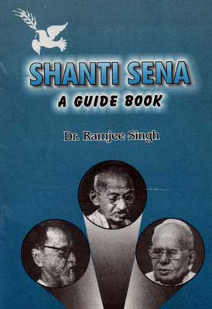
Notes:
Before I explain any further, let me take us back in history a ittle way. The Nonviolent Peaceforce is based on Gandhi's concept of “Shanti Sena”, which means a troop of unarmed people who are trained in satyagraha. They work actively for justice and peace in conflict situations. When an attack seems imminent, they take action to avert the threat.

Slide 44
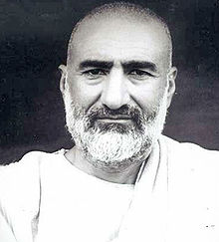
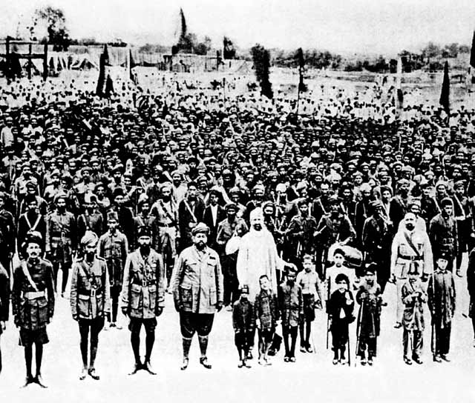
Abdul Ghaffar Khan.
1890-1988
"Patience and righteousness!"
Nonviolent troop
Khudai Kidmatgar Servants of God
„And not equal are the good deed and the bad. Repel [evil] by that [deed] which is better; and thereupon the one whom between you and him is enmity [will become] as though he was a devoted friend.“ Sura 41, 34 (35)
Notes:
The first nonviolent troop was established by the Muslim Abdul Ghaffar Khan with thousands of men and hundreds of women in Northern India as early as in 1929. Abdul Ghaffar Khan was a close friend of Gandhi.

Slide 45
Abdul Ghaffar Khan.
1890-1988
"Patience and righteousness!"
Nonviolent troop
Khudai Kidmatgar Servants of God
„And not equal are the good deed and the bad. Repel [evil] by that [deed] which is better; and thereupon the one whom between you and him is enmity [will become] as though he was a devoted friend.“ Sura 41, 34 (35)
Notes:
In resistance to British colonial rule in India and to overcome the backwardness of his own society, this Pashtun man set up a non-violent troop, the Khudai Kidmatgar, Servants of God, who were also called “Red Shirts”. They were well prepared and systematically trained in satyagraha.

Slide 46
Abdul Ghaffar Khan.
1890-1988
"Patience and righteousness!"
Nonviolent troop
Khudai Kidmatgar Servants of God
„And not equal are the good deed and the bad. Repel [evil] by that [deed] which is better; and thereupon the one whom between you and him is enmity [will become] as though he was a devoted friend.“ Sura 41, 34 (35)
Notes:
Their great willingness to commit themselves brought about the political recognition of the "North-West Province" with limited voting rights and indirect participation in government by the "servants of God“ in the 1930s. The province is now part of Pakistan.

Slide 47
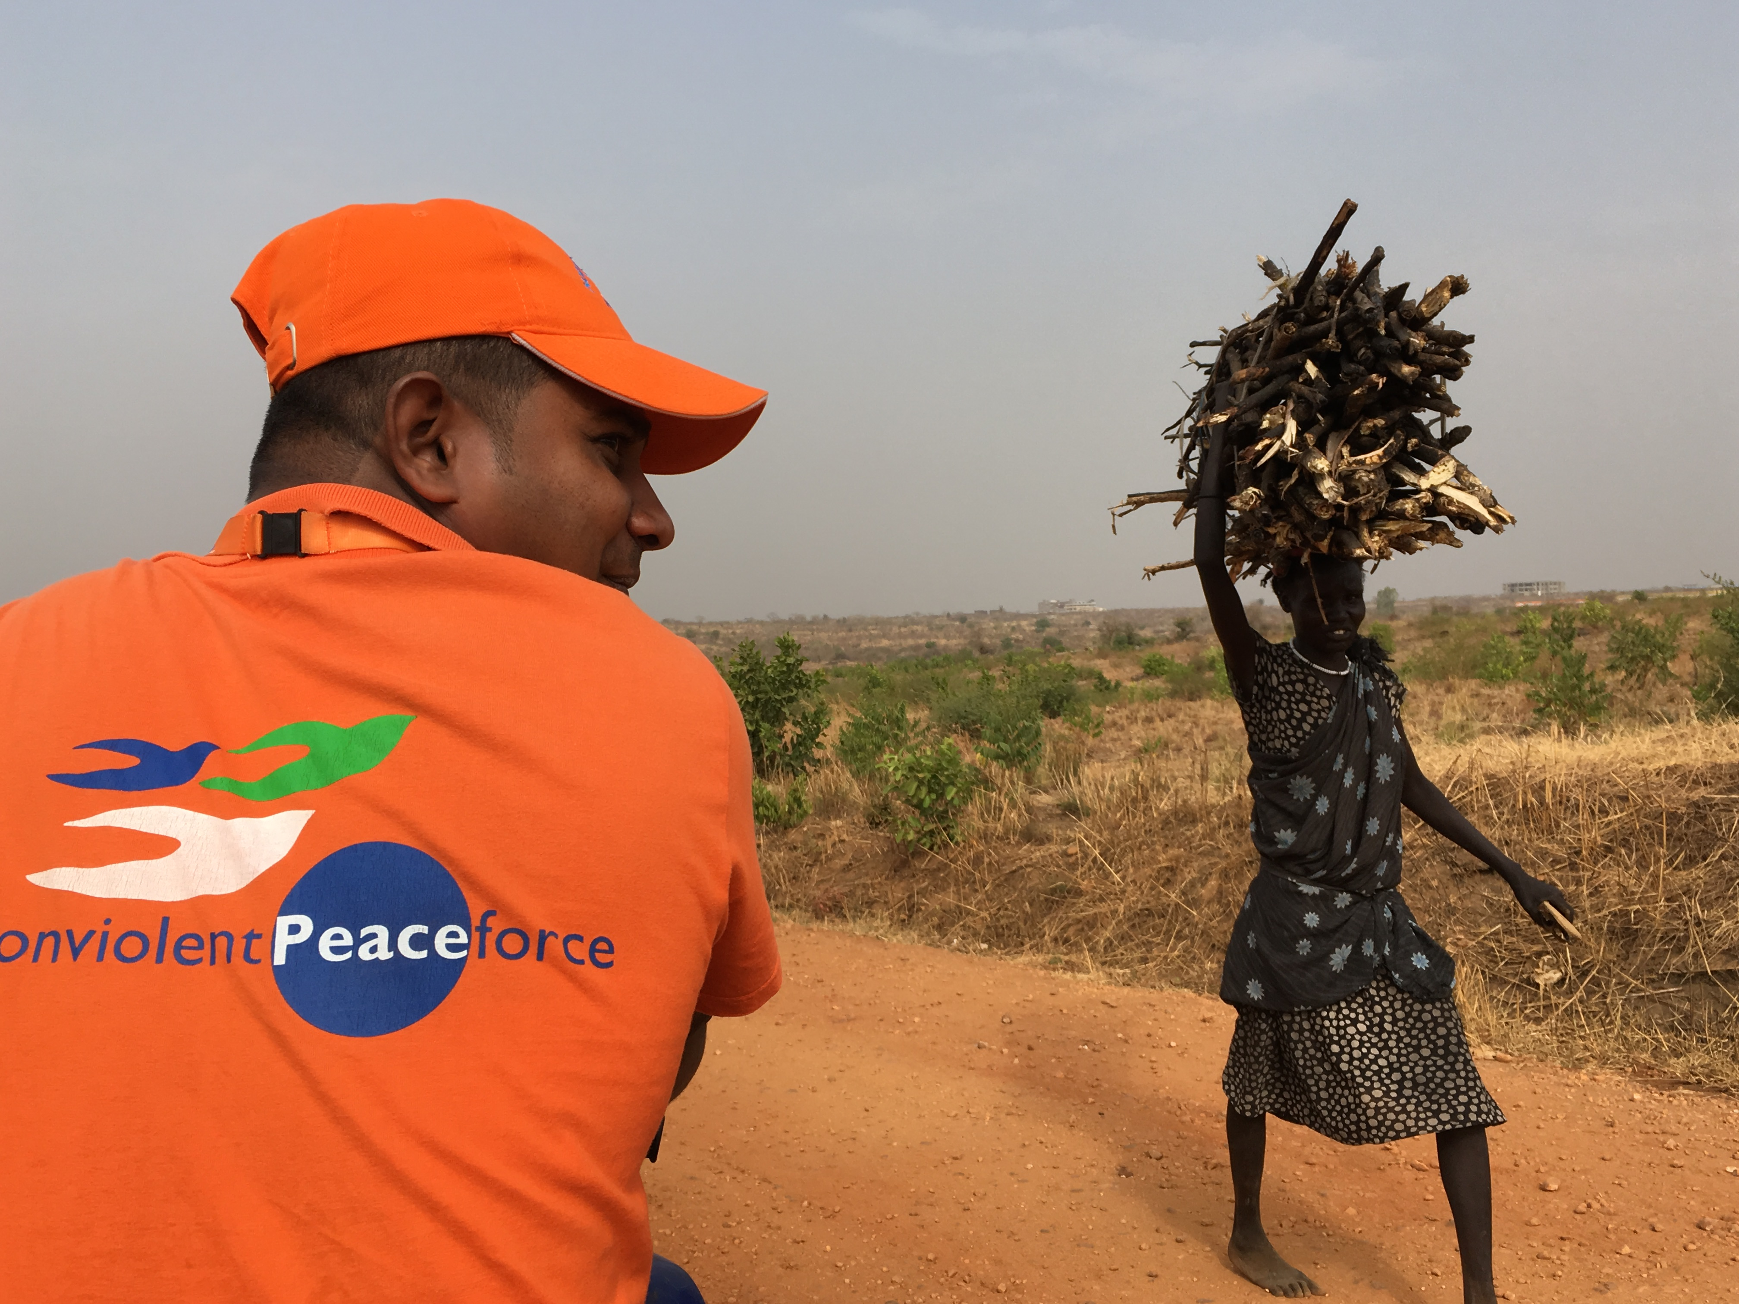
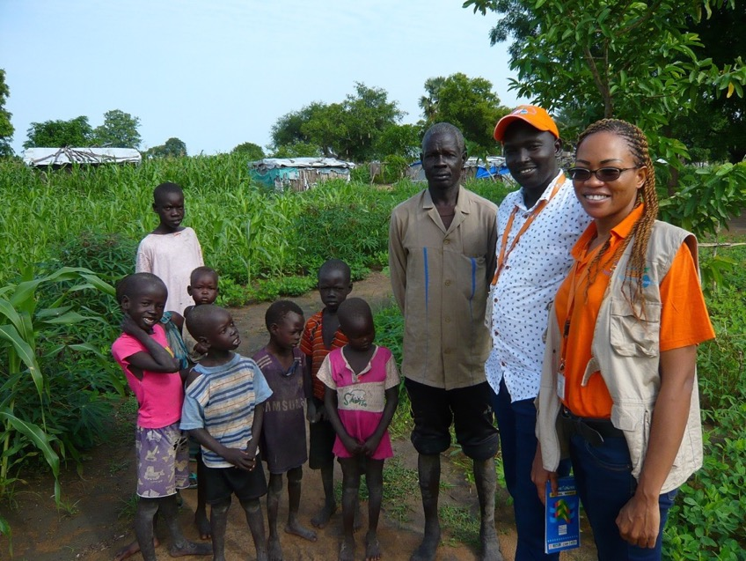
Nonviolent Peaceforce: Mission
Protect civilians in situations of violent conflict by means of satyagraha.
Working for peace alongside local communities.
Working to spread the model of deployment as a means of defending the life and dignity of people in regions of conflict.
Notes:
Back to the 21st century: Nonviolent Peaceforce protects civilians in situations of violent conflict through satyagraha. It works for peace alongside local communities. And it works to spread the model of deployment as a method of protecting life and dignity of people in regions of conflict.

Slide 48
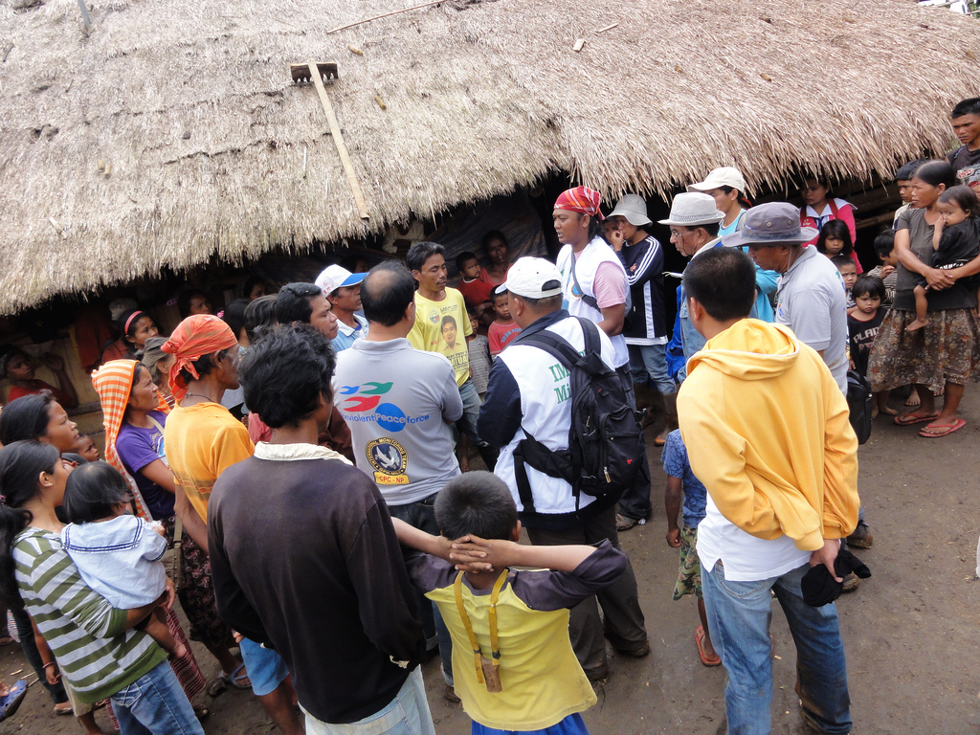
Notes:
Nonviolent Peaceforce groups of up to 100 activists, both international and local,
establish preventive protection, e.g. by monitoring and controlling rumours;
monitor ceasefire agreements;
1. Vorbeugenden Schutz aufbauen
Kontrolle von Gerüchten
2. Aufbau von Frühwarnsystemen
Monitoring von Waffenstillstand-Vereinbarungen in Mindanao
3. Bereitstellung von sicheren Räumen
Waffenfreie Zonen in Südsudan

Slide 49
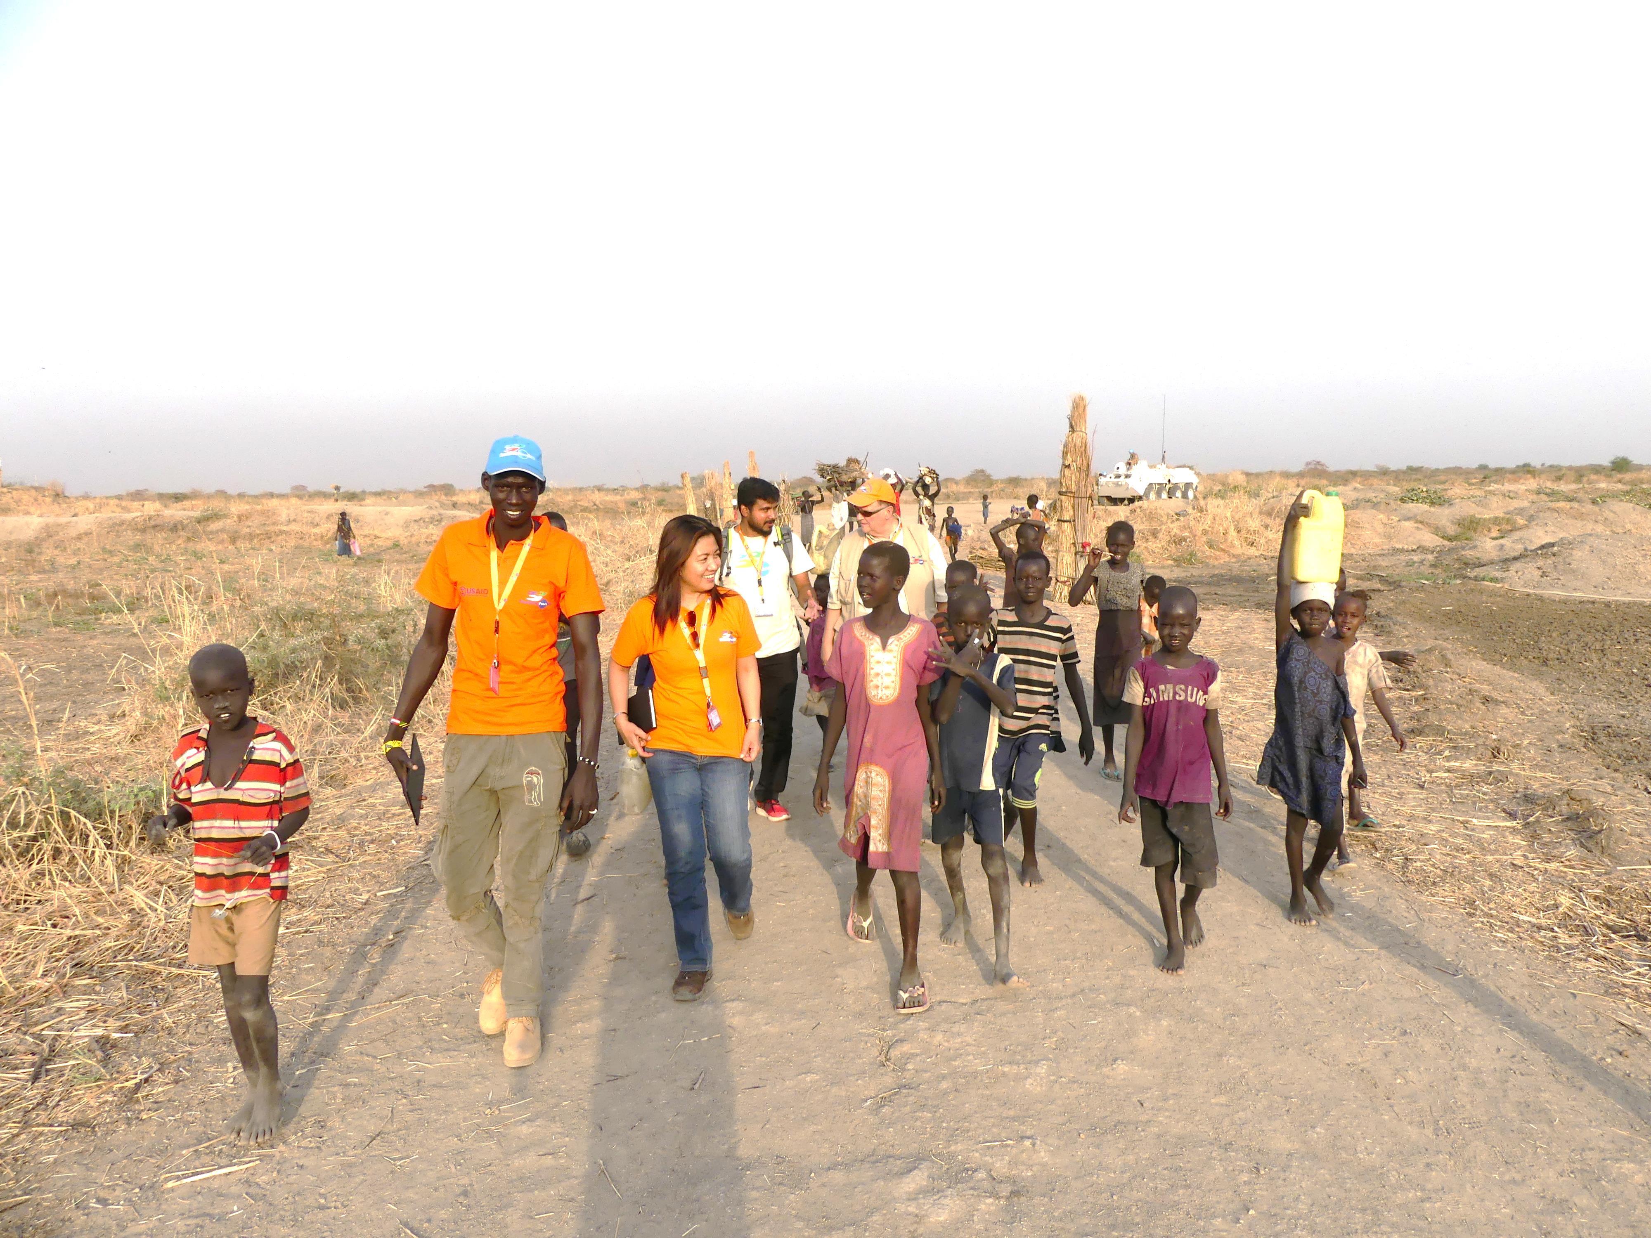
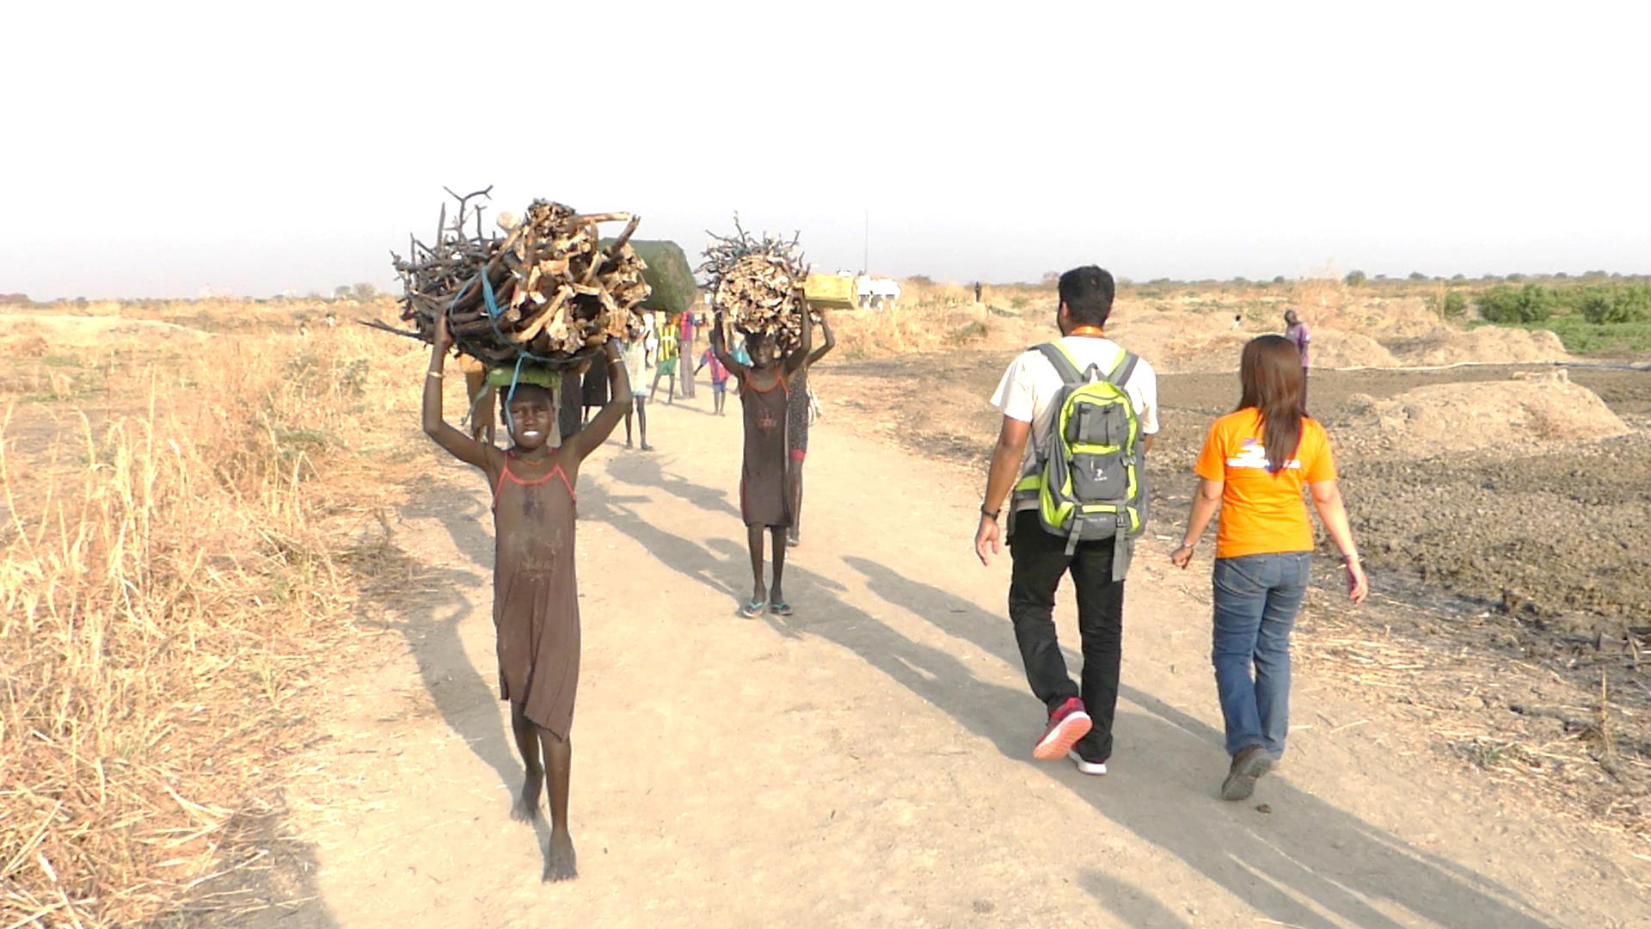
Notes:
accompany people who carry water through dangerous areas or they serve as observers in particular places;

Slide 50
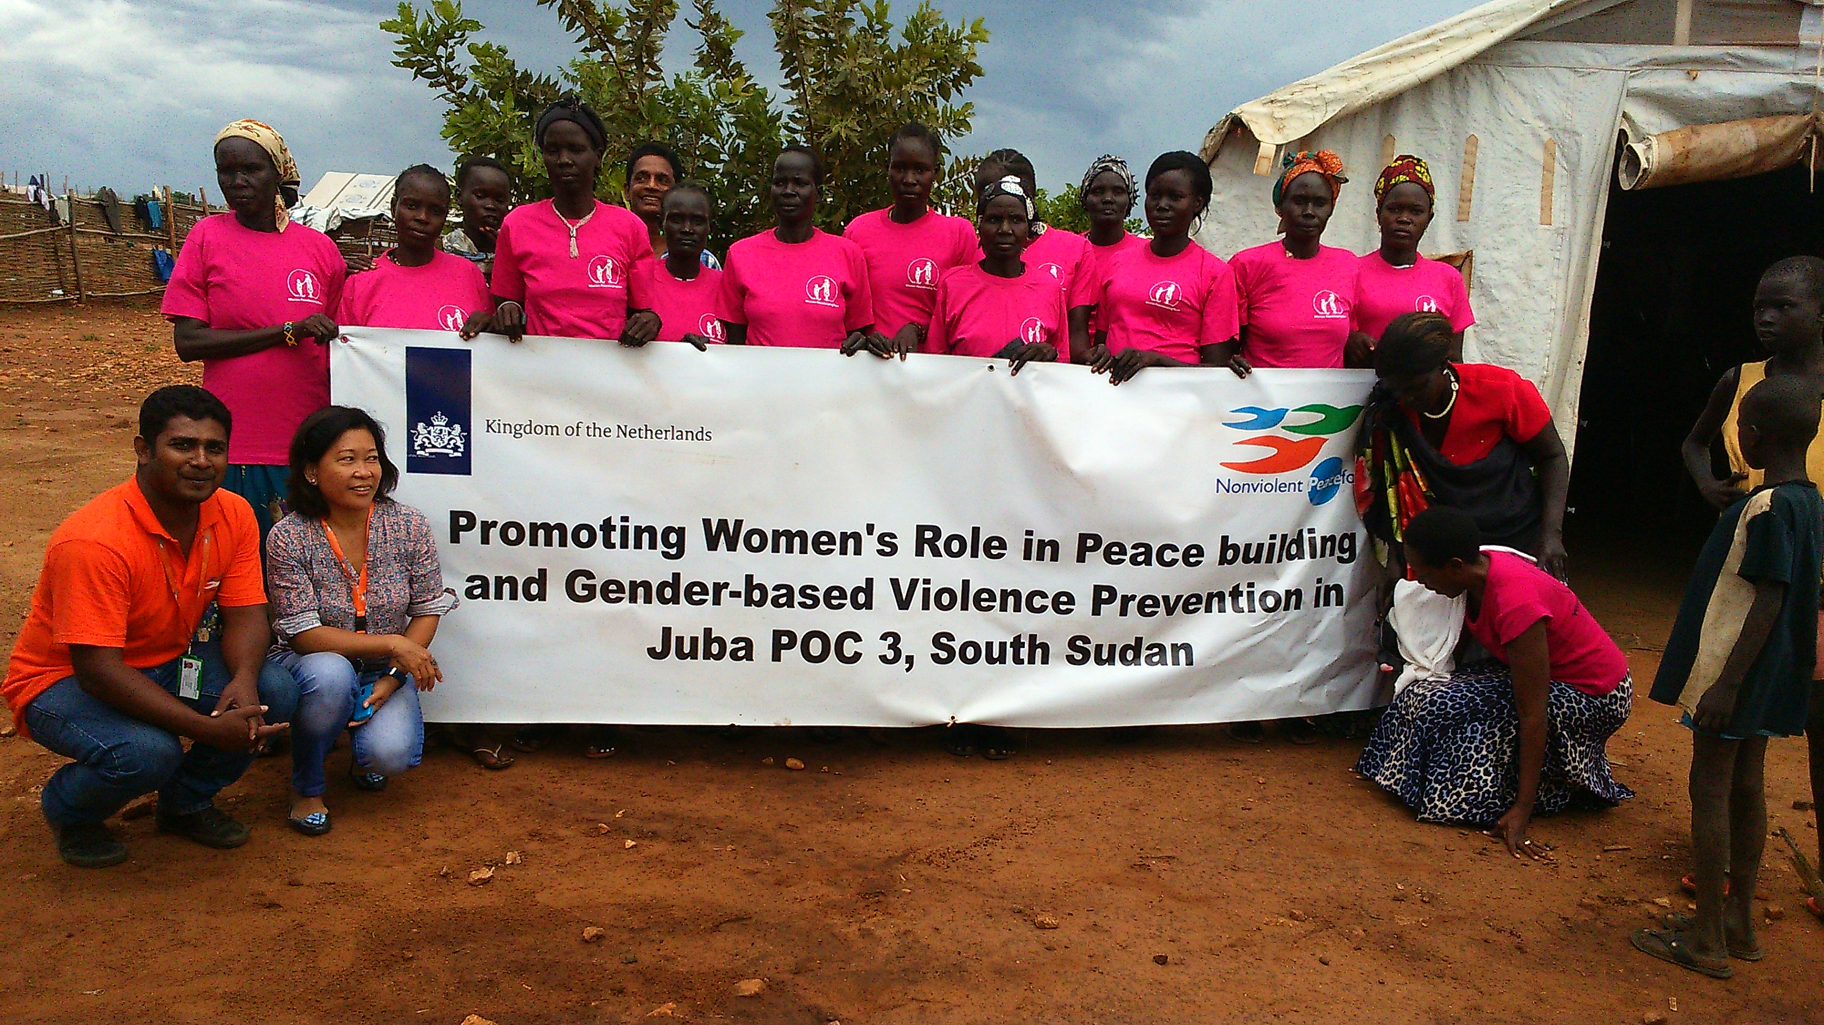
Training for local organisations
Notes:
provide training for local organisations;
1. Vorbeugenden Schutz aufbauen
Kontrolle von Gerüchten
2. Aufbau von Frühwarnsystemen
Monitoring von Waffenstillstand-Vereinbarungen in Mindanao
3. Bereitstellung von sicheren Räumen
Waffenfreie Zonen in Südsudan

Slide 51
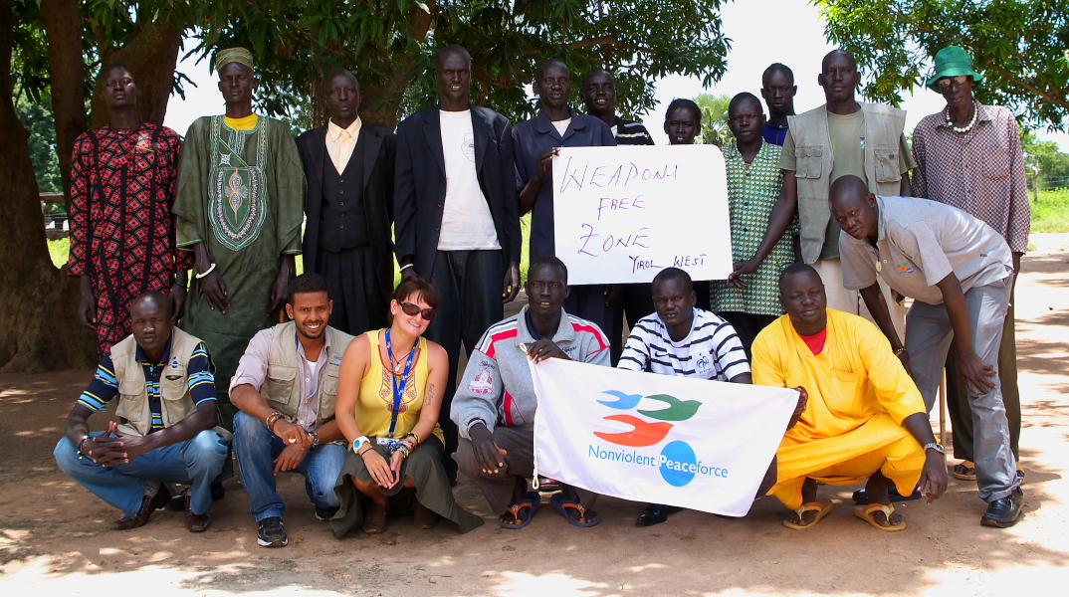
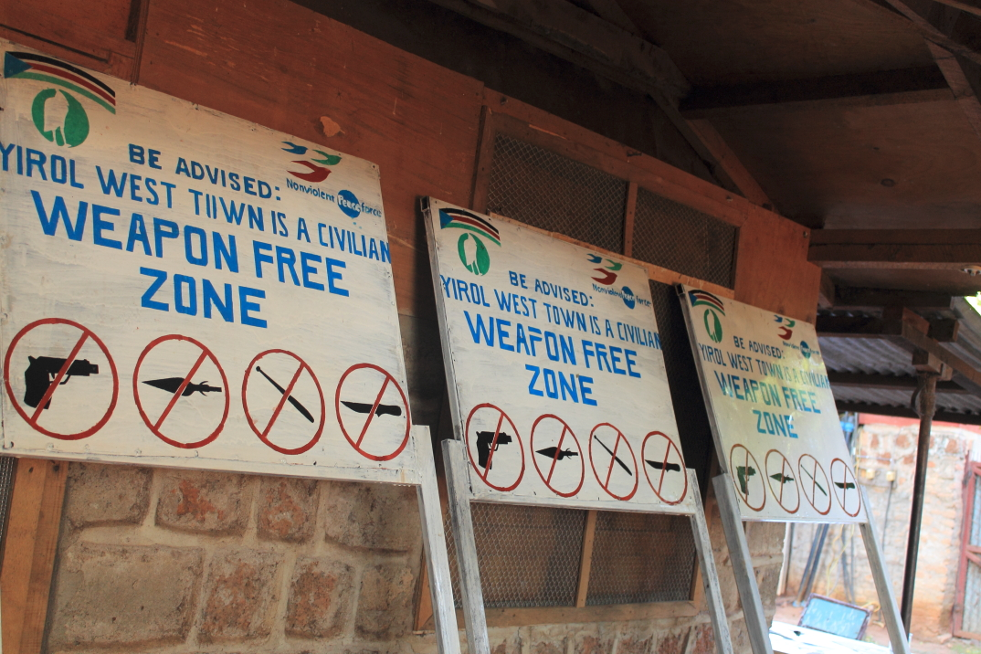
Notes:
establish early warning systems for example in the Philippines following the ceasefire agreements;
establish safe spaces or areas such as weapon-free zones in South Sudan for example.
1. Vorbeugenden Schutz aufbauen
Kontrolle von Gerüchten
2. Aufbau von Frühwarnsystemen
Monitoring von Waffenstillstand-Vereinbarungen in Mindanao
3. Bereitstellung von sicheren Räumen
Waffenfreie Zonen in Südsudan

Slide 52
How does civil peacekeeping work?
Trained unarmed civil peacekeepers, national and international, protect people.
Capacity building of local civil society organisations and municipalities.
Promotion of existing capacities of local peace or security structures.
Notes:
Nonviolent Peaceforce protects people and prevents violence between those involved in conflict. It has been recognised by the UN as an agent of Civil Peacekeeping. Nonviolent Peaceforce is currently active in Iraq, Myanmar, the Philippines, and South Sudan.
Ausgebildete unbewaffnete zivile Peacekeeper, nationale und internationale, schützen Menschen
Aufbau der Kapazitäten der lokalen zivil-gesellschaftlichen Organisationen und Kommunen
Fördern der vorhandenen Kapazitäten lokaler Friedens- oder Sicherheitsstrukturen

Slide 53
Since the 1960ies people engaged worldwide developed different concepts for satyagraha intervention in different situations of thread:
Peace Brigades International: Accompagning people, who are in danger because they engage for human rights
Christian Peacemaker Teams, founded by Mennonites, work worldwide.
Ecumenical Accompagning Programme in Palästina and Israel founded by the World Council of Churches (EAPPI)
Ziviler Friedensdienst Civil Peace Service in Germany
worked in the former Yugoslawia
Nonviolent Peaceforce – Unarmed Civilian Protection
work in Lateinamerika
Notes:
Other initiatives and organisations are working in a similar way. Most of them were founded during the last century. All of them are beacons of hope. They show that even in war zones it is possible to behave peacefully and to foster living together peacefully .

Slide 54
Practicing satyagraha, the Power of goodness, in the 21st Century
Fridays for Future
The terms nonviolence, satyagraha, Power of goodness
Satyagraha: a turning point in human history
Satyagraha since the beginning of the 21st century
15.2.2003: biggest protest event in human history
“Antiglobalization movement“ / Social Forums
Nonviolent Peaceforce
Otpor in Serbia and Arab spring
Notes:
Serbia is a little country in the southern Europe. The Serbian nonviolent movement Otpor, which means Resistance, was founded in 1998 against the policies of Milošević who was President of Serbia at the time and ruled like a dictator. They were able to overthrow him by influencing elections in 2000.

Slide 55
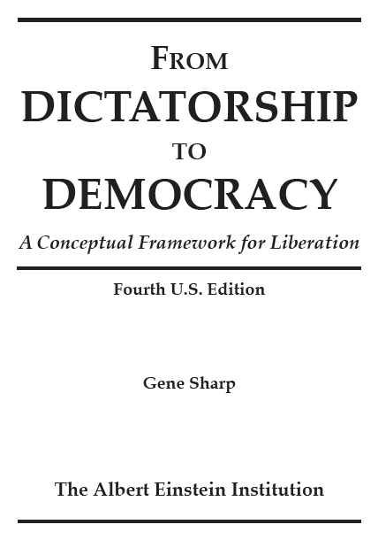
Notes:
The interesting point here is the way of learning. The young founders of Otpor learned among other sources from Gene Sharp’s studies on nonviolence, in particular from the booklet “From Dictatorship to Democracy” which was translated into many languages, including Serbian, and is also available online.

Slide 56
Notes:
Several handbooks on nonviolent struggle have been published in recent decades.

Slide 57
Notes:
A documentary film was made about the Otpor movement, called “Bringing down a dictator”, and has been shown in many countries.

Slide 58
Notes:
And there is also a Otpor booklet Nonviolent struggle – 50 crucial points.

Slide 59
Notes:
Activists of Otpor founded a new organisation called Centre for Applied Non Violent Action & Strategies CANVAS.

Slide 60
CANVAS Analytic Department
September, 2010
SUBJECT: Analysis of the situation in Venezuela, September 2010. (DRAFT)
Notes:
They published analyses of the Situation in other countries an offered help for revolutionary movements.

Slide 61
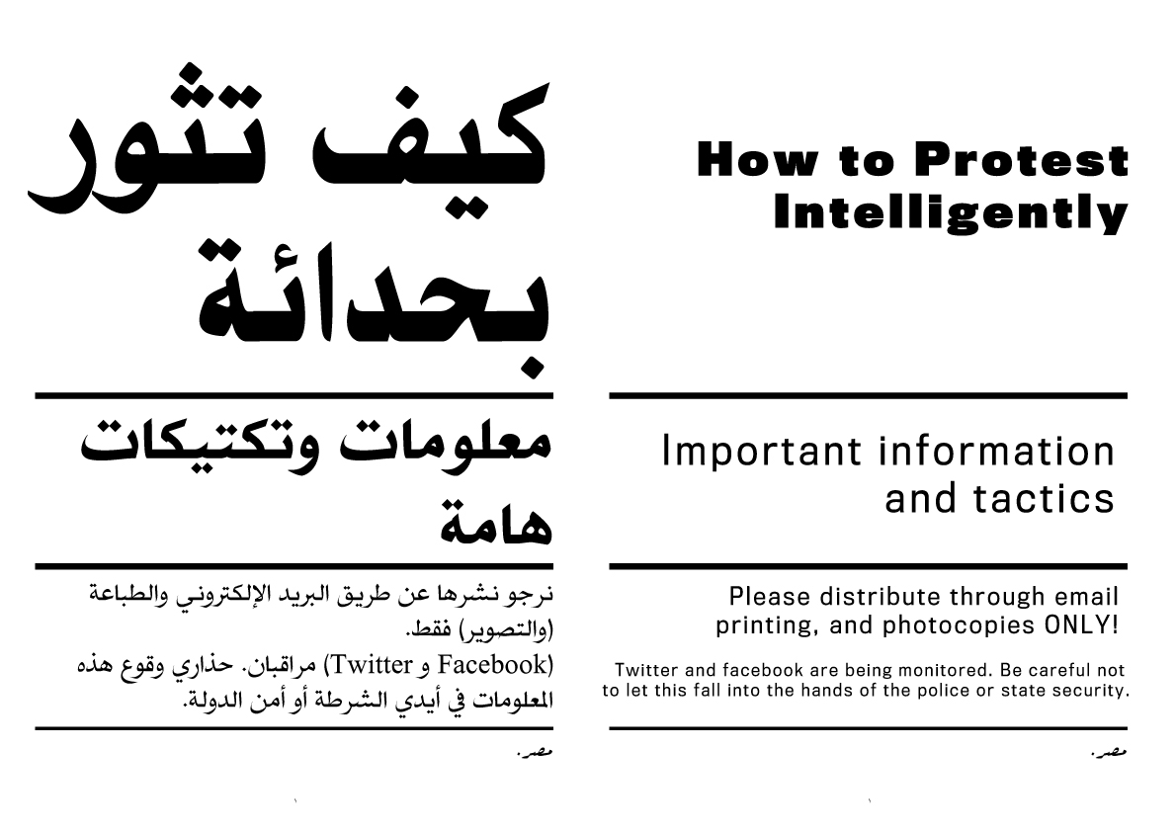
Notes:
So, among with groups of many countries, a group of young Egyptians attended a seminar for knowledge disseminators in Serbia. Back in Egypt they edited the booklet How to Protest Intelligently …

Slide 62
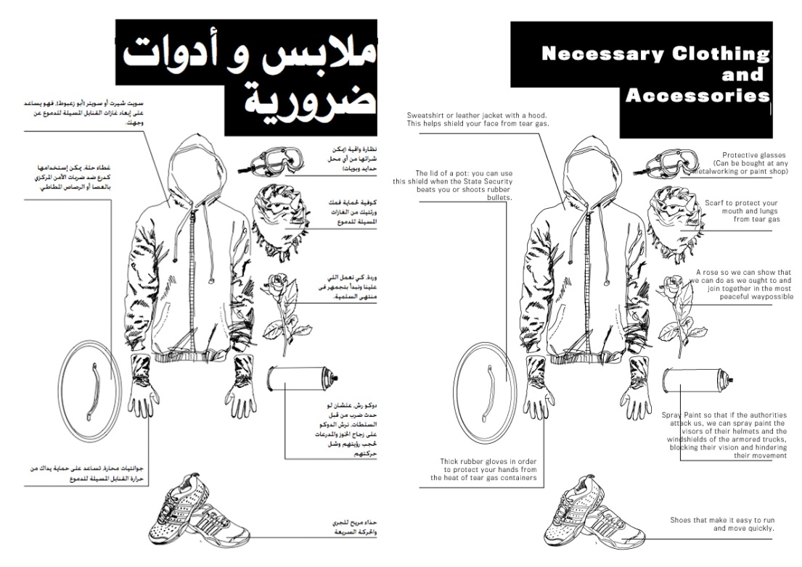
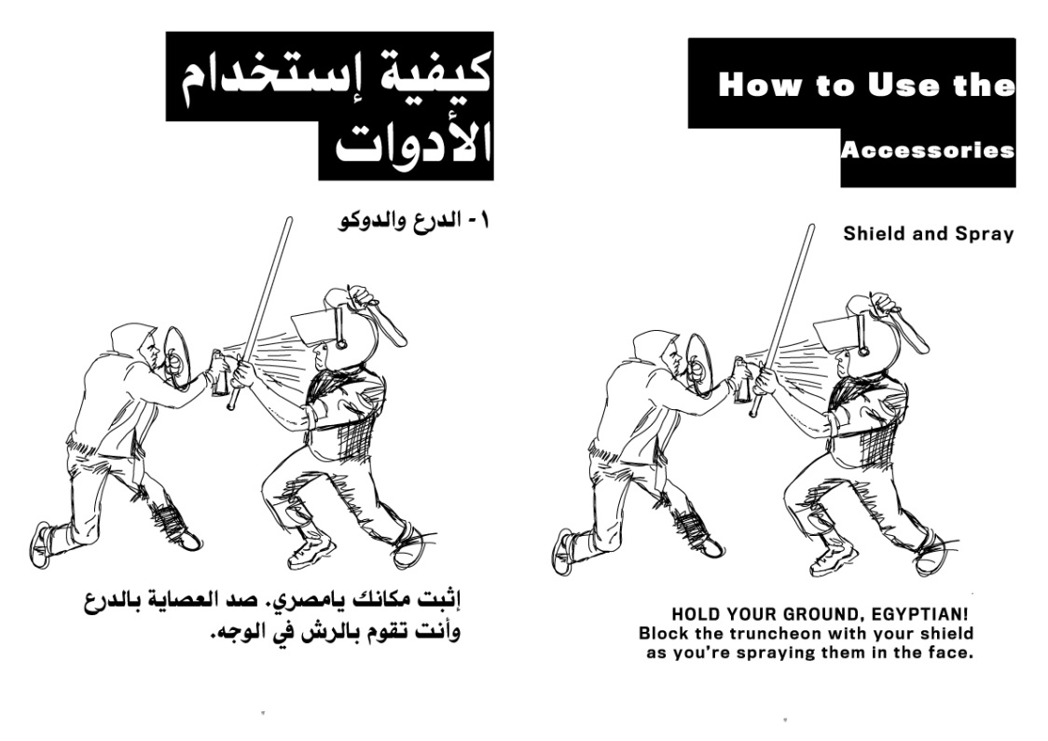
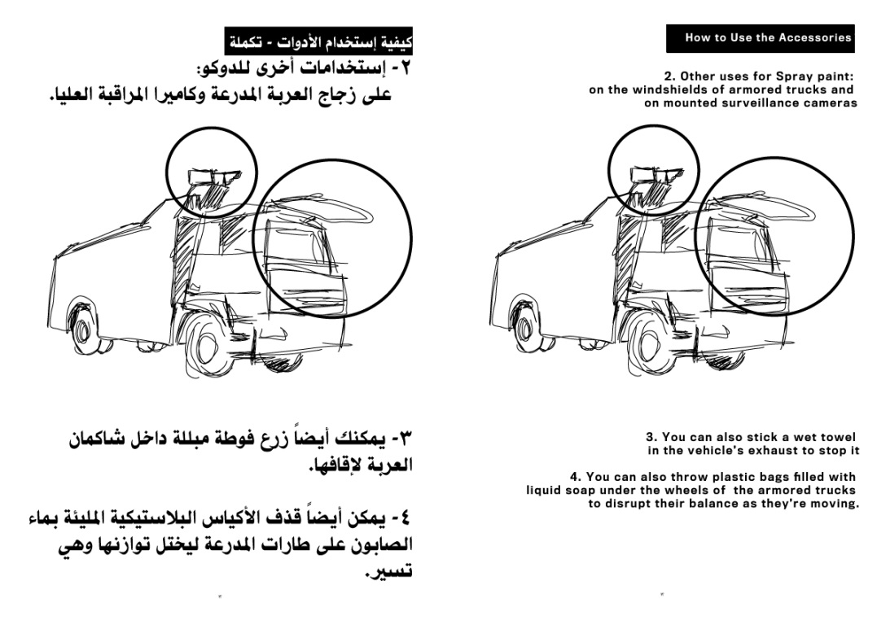
Notes:
… both in Arabic and in English and spread it in underground circles. The booklet included a lot of tactical hints including necessary clothing and accessoires and hints up to how to use such things.

Slide 63
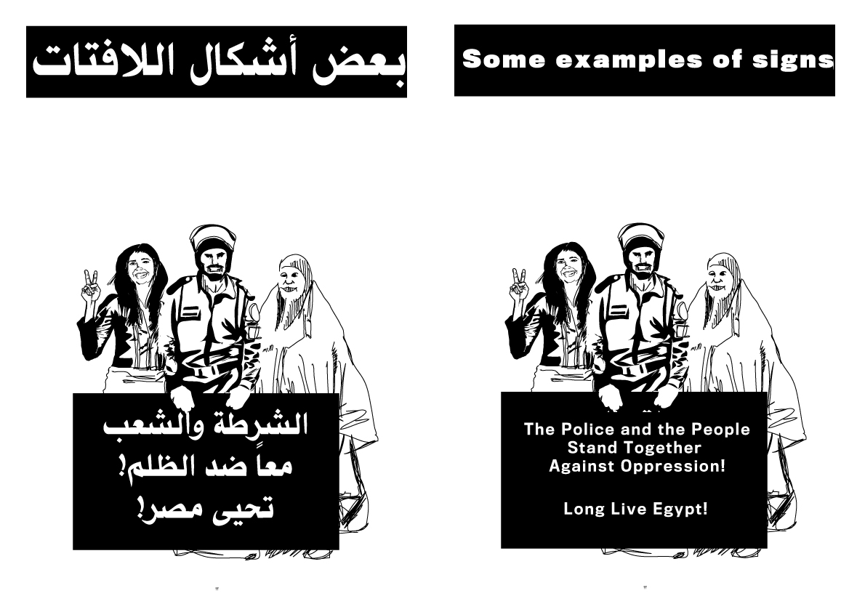
Notes:
It also included the model sign “The Police and the People Stand Together - Against Oppression! - Long Live Egypt !“ So they built up the basis for a future movement.

Slide 64
Notes:
They were first to use Facebook on a broad scale so their strong impulses resulted in the overthrow of Egypt‘s president Mubarak.

Slide 65
Notes:
After Tunisia, Egypt was the second country in which the presidency of a dicatator was ended by nonviolent means in 2011. These events took the whole world by surprise.

Slide 66
Notes:
These uprisings and others inspired by them in other Arab countries were called the Arab spring.

Slide 67
Notes:
Things developed in these countries in very different ways. We can learn from these differences:

Slide 68
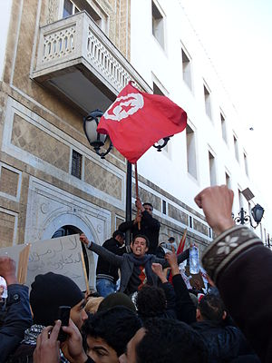
Notes:
In Tunisia the uprising was triggered by the self-immolation of a young man. The president, Ben Ali, was abroad at the time. He did not dare to return home.

Slide 69
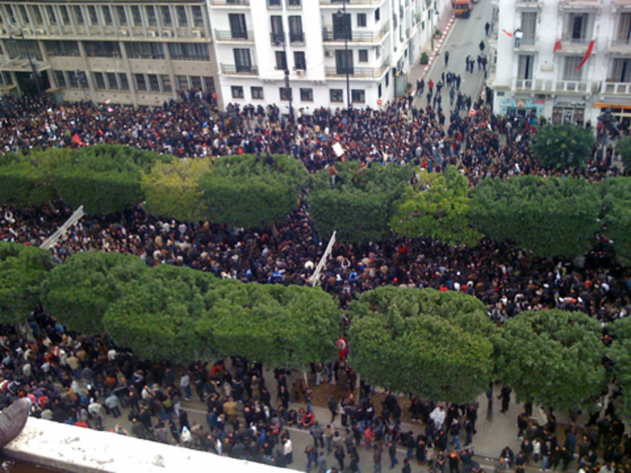
Notes:
That was the first quick success of the movement.

Slide 70
Notes:
Today, 9 years later, the achievements of the revolution in Tunisia have been much better maintained than in Egypt. Why is this?

Slide 71
Notes:
We can already see this already at the beginning. There had long been a well developed civil society in Tunisia. A lot of groups and several political parties were well aware at the political events. Many people are used to demonstrating and they make their demands openly.

Slide 72
Notes:
The government was unable to prevent this, beause the demonstrators were and are courageous and they were so many of them. So, they were strong because of their courage and training in civil action. That‘s why the president chose not to return.

Slide 73
Notes:
The movement in Egypt was quite new and there was a big start. The leaders and many of the participants were trained - mostly in tactics.

Slide 74
Notes:
The elaborate civil society in Tunisia had much more experience over a longer period of time. So we can learn,

Slide 75
Notes:
that the lasting strength of a movement is favoured not by waiting for the movement to come, but by practicing an attitude of „civil courage“ in every day life and learning together in structures which provide mutual support.

Slide 76
Practicing satyagraha, the Power of goodness, in the 21st Century
Fridays for Future
The terms nonviolence, satyagraha, Power of goodness
Satyagraha: a turning point in human history
Satyagraha since the beginning of the 21st century
15.2.2003: biggest protest event in human history
“Antiglobalization movement“ / Social Forums
Nonviolent Peaceforce
Otpor in Serbia and Arab spring
3 main dynamic aspects of the satyagraha approach
Notes:
That leads me to the more general aspects of satyagraha.

Slide 77
Practicing satyagraha, the Power of goodness, in the 21st Century
3 main dynamic aspects of the satyagraha approach:*
Independent action
“Contagion” / resonance
(Mass) non-cooperation
* www.martin-arnold.eu
© Martin Arnold
Notes:
In the course of my research I discovered three main dynamic aspects of the satyagraha approach: Independent Action, 'contagion' or Resonance and mass non-cooperation.

Slide 78
Practicing satyagraha, the Power of goodness, in the 21st Century
3 main dynamic aspects of the satyagraha approach:*
Independent action
„The most persuasive form to say NO to the unacceptable is to do YES for the more mature possibilities.“ (Birgit Berg, workshop for poetry and politics)
Notes:
Independent Action means: it is stronger to act than to react. According to Birgit Berg‘s insight : „The most persuasive form to say NO to the unacceptable is to do YES for the more mature possibilities.“
(Werkstatt für Poesie und Politk)

Slide 79
Practicing satyagraha, the Power of goodness, in the 21st Century
3 main dynamic aspects of the satyagraha approach:*
Independent action
„The most persuasive form to say NO to the unacceptable is to do YES for the more mature possibilities.“ (Birgit Berg, workshop for poetry and politics)
Notes:
This corresponds to Gandhi‘s constructive programme as an essential part of satyagraha, hand spinning and so on. A constructive programme can involve both individual and collective action.

Slide 80
Practicing satyagraha, the Power of goodness, in the 21st Century
3 main dynamic aspects of the satyagraha approach:*
Independent action
“Contagion” / resonance
* www.martin-arnold.eu
© Martin Arnold
Notes:
What 'contagion' or Resonance means depends on how big the grievance or social wrong is. Sometimes a single person can put things right on their own. Resonance is not nessesary. But in other cases it is important that other people join the initiative.

Slide 81
Practicing satyagraha, the Power of goodness, in the 21st Century
3 main dynamic aspects of the satyagraha approach:*
Independent action
“Contagion” / resonance
* www.martin-arnold.eu
© Martin Arnold
Notes:
This works best, when people have already begun doing good. Because doing good is a need of every human being like speaking.

Slide 82
Practicing satyagraha, the Power of goodness, in the 21st Century
3 main dynamic aspects of the satyagraha approach:*
Independent action
“Contagion” / resonance
* www.martin-arnold.eu
© Martin Arnold
Notes:
in this case, something inside responds to the vibration coming from the other person or persons. And there is a resonance which leads to action.

Slide 83
Practicing satyagraha, the Power of goodness, in the 21st Century
3 main dynamic aspects of the satyagraha approach:*
Independent action
“Contagion” / resonance
* www.martin-arnold.eu
© Martin Arnold
Notes:
This phenomenon leads movements to grow, sometimes very rapidly like the spread of a contagious desease, except that the contagion is healthy !

Slide 84
Practicing satyagraha, the Power of goodness, in the 21st Century
3 main dynamic aspects of the satyagraha approach:*
Independent action
“Contagion” / resonance
(Mass) non-cooperation
* www.martin-arnold.eu
© Martin Arnold
Notes:
The third factor which is important for success is non-cooperation. That means: Not supporting the wrong.

Slide 85
Practicing satyagraha, the Power of goodness, in the 21st Century
3 main dynamic aspects of the satyagraha approach:*
Independent action
“Contagion” / resonance
(Mass) non-cooperation
* www.martin-arnold.eu
© Martin Arnold
Notes:
Taking this seriously requires looking at myself to find out where and how I might be support the wrong, even though if I don‘t want to.

Slide 86
Practicing satyagraha, the Power of goodness, in the 21st Century
3 main dynamic aspects of the satyagraha approach:*
Independent action
“Contagion” / resonance
(Mass) non-cooperation
* www.martin-arnold.eu
© Martin Arnold
Notes:
Reducing my own part in a wrong makes the wrong weaker. Where major grievances are concerned, if large numbers of people refuse to cooperate with a wrong, it can be overcome.

Slide 87
Practicing satyagraha, the Power of goodness, in the 21st Century
Fridays for Future
The terms nonviolence, satyagraha, Power of goodness
Satyagraha: a turning point in human history
Satyagraha since the beginning of the 21st century
15.2.2003: biggest protest event in human history
“Antiglobalization movement“ / Social Forums
Nonviolent Peaceforce
Otpor in Serbia and Arab spring
3 main dynamic aspects of the satyagraha approach
Rules of satyagraha (in a general sense)
Notes:
I would like to conclude by presenting another result of my research: Rules of satyagraha (in a general sense)

Slide 88
Practicing satyagraha, the Power of goodness, in the 21st Century
Rules of satyagraha (in a general sense)*
- Trust in other powers, in life, in God;
- show courage even when you are frightened;
- make benevolent contact with the others involved;
- do not cooperate with injustice by simply watching or playing a part in it;
- be prepared to bear the associated costs and take the risks upon yourself;
- do not harm others;
- be persistent and do not give way
- come up with new ideas, behave as constructively as possible;
- insist on humanity and justice.
* www.martin-arnold.eu
© Martin Arnold
Notes:
By comparing different concepts I found these „Rules for satyagraha (in a general sense)”: - Trust in other powers; - Show courage; - Make benevolent contact with the others involved; - Do not cooperate with injustice; - Take the risks upon yourself; - Do not harm others; - Do not give way; - Behave constructively; - Insist on humanity and justice.

Slide 89
Power of Goodness

Slide 90
Fruits of the research
Texts, audio and visual media in German and in English www.martin-arnold.eu
Many satyagraha reports (German…): kraft-der-guete.blogspot.com
Notes:
Thank you all for listening, I look forward to our discussion.

